Slide 1
GARFIELD AVENUE COMPLETE STREET IMPROVEMENT PROJECT
Public Outreach Meeting
November 4, 2021
City of South Gate
GATEWAY
TO THE
FUTURE

Slide 2
Today’s Agenda
Introductions
City of South Gate
Arturo Cervantes, Assistant City Manager/Director of Public Works
Elias Saikaly, Project Manager
Tetra Tech
Jason Fussel; Vice President
Meeting Purpose
Obtain Public Input
Present the Garfield Ave Complete Street Project
Garfield Avenue Issues

Slide 3
Garfield Avenue Complete Street
Description
Primary Arterial Corridor of Regional Significance
Over 20,000 vehicles travel on Garfield Avenue daily
Serves Commercial, Industrial and Residential land uses
Challenges
Aging Pavement Infrastructure
Safety
Congestion and Delay
Pedestrian, Bike and ADA Accessibility

Slide 4
Garfield Ave Complete St. Improvements
Project Purpose | Project Details
Mitigate Issues on the Corridor | Firestone Boulevard to Jefferson Avenue
Pedestrian Safety | Sidewalk repairs, Curb Ramps and ADA improvements
Bike Safety | Sharrows, bike lanes, signage and bike racks
Traffic Circulation and Safety | Road medians to reduce turning movements and to enhance safety
Deferred Maintenance | Repaving the roadway, repairing sidewalks and constructing new ADA compliant curb ramps
Greening Corridor | Drought tolerant landscaping and storm water quality mitigations
Beautification | Landscaping and new street furniture

Slide 5
Typical Section

Slide 6
Roadway Median Plan

Slide 7
Median Island Location
Proposed Median Island

Slide 8
Landscape Concept Plan

Slide 9
Proposed Design Concept

Slide 10
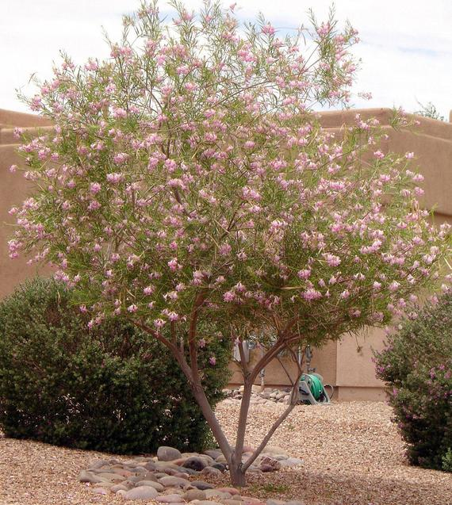
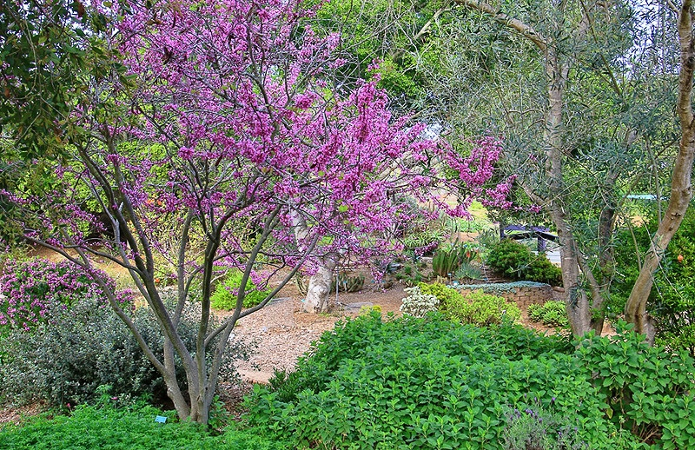
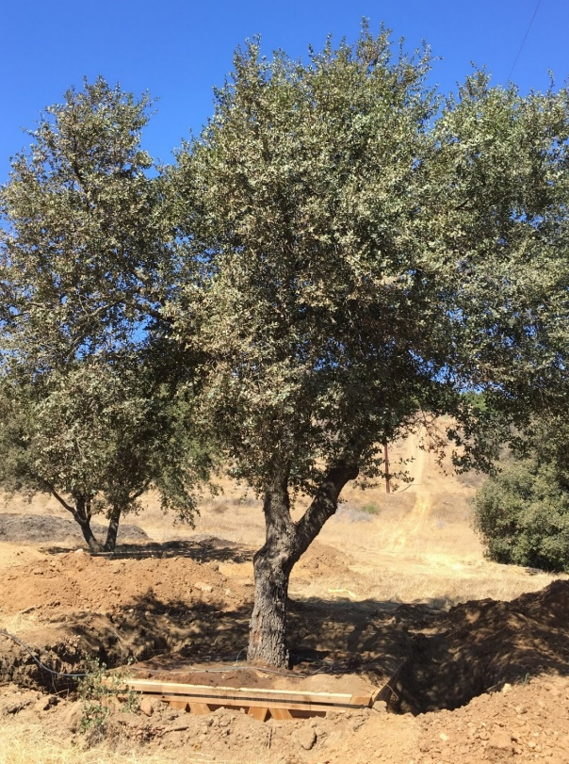
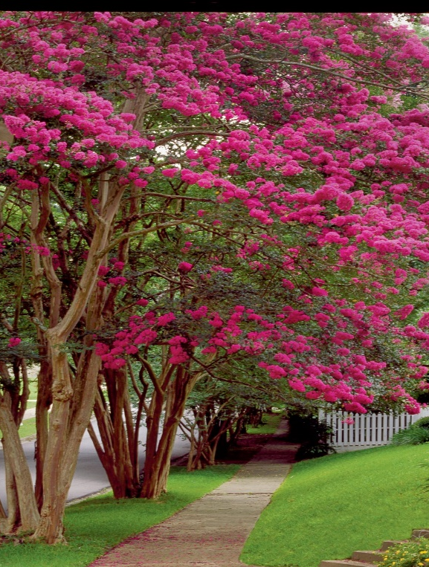
Landscape Concept Plan – Trees Palette
Desert Willow
Western Redbud
Engelmann Oak
Crepe Myrtle

Slide 11
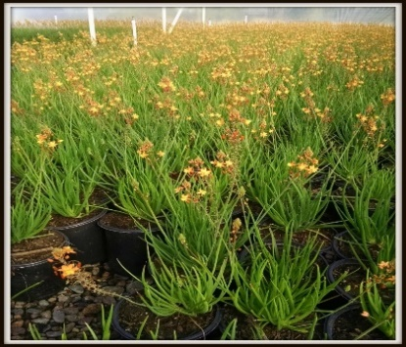
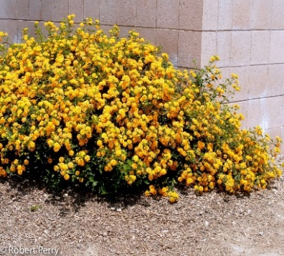
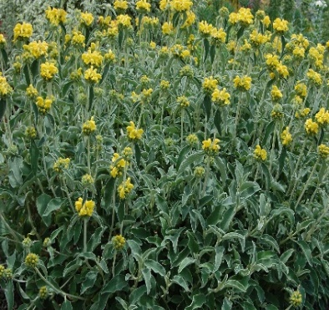
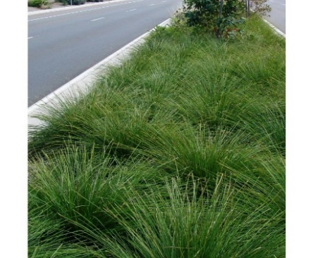
Landscape Concept Plan – Plant Palette
Tangerine Bulbine
Golden Lantana
Sage
Mat Rush Grass

Slide 12
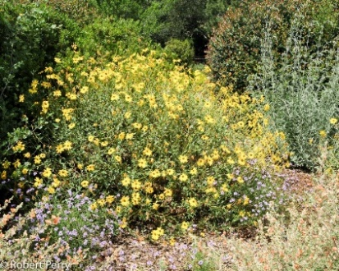
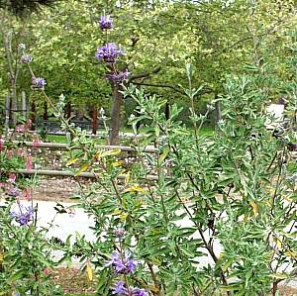
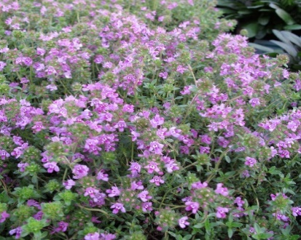
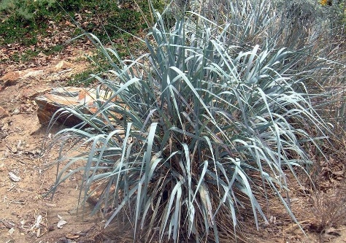
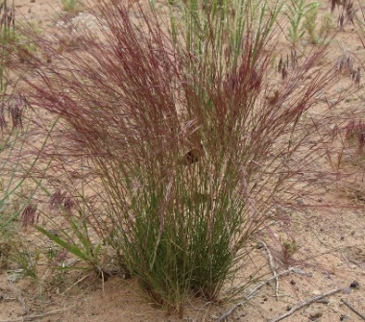
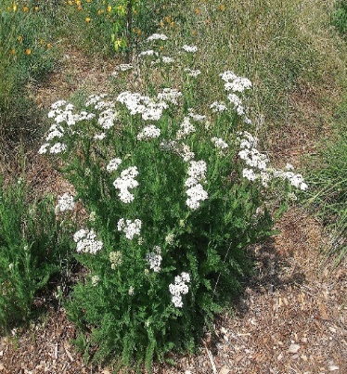
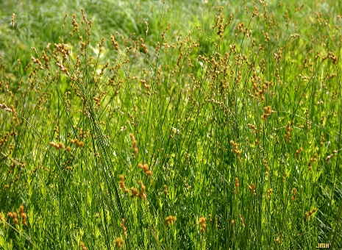
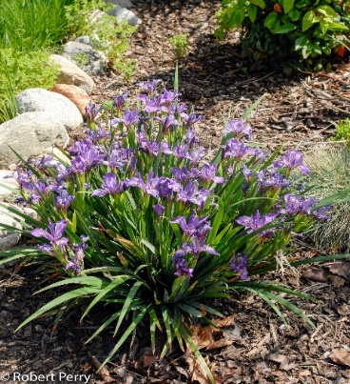
Landscape Concept Plan – Plant Palette
Bush Sunflow Sage Sage Giant Wildrye
Purple Grass CA Yarrow Field Sage Iris Plant

Slide 13
Streetscape Amenities

Slide 14
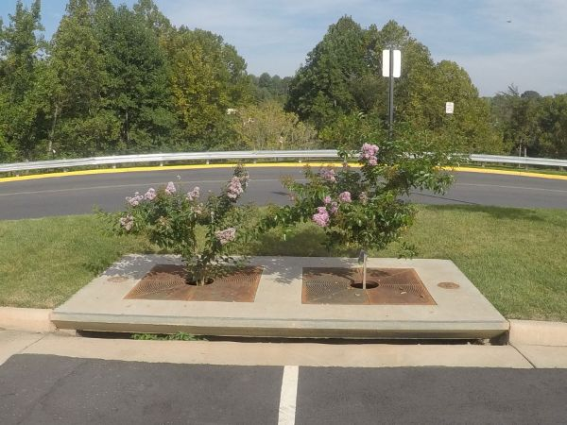
Bio-Filtration Well

Slide 15
Roadway Bike Plan
Hollydale Park

Slide 16
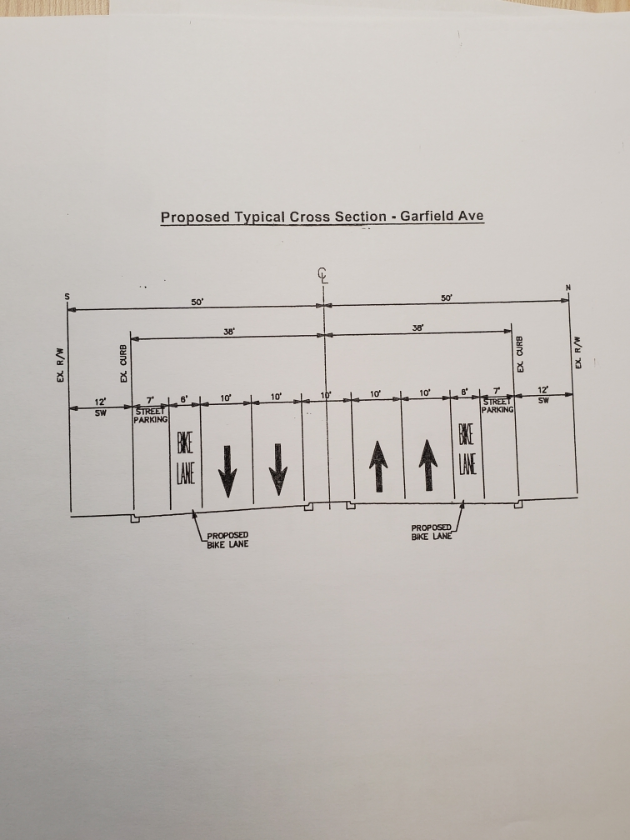
Typical Section

Slide 17
Public Communications
Elias Saikaly Project Engineer, esaikaly@sogate.org or 323.563.9581
Design Phase
Project Information Mailer
Public Outreach Meetings
Construction Phase
City’s Construction Notice
Construction Alerts
Contractor’s Construction Notice
Changeable Message Board
Other
Project website; CIPimprovements@sogate.org

Slide 18
Project’s Planned Budget
Activity Costs
Design Phase with Contingencies $ 800,000
Construction Phase $5,000,000
Inspection, Management/Contingencies $ 750,000
Total $6,550,000
Funding Sources:
The project is Funded by Federal Funds: ATP Grant, HSIP Grant, other Funds; Measure M, TDA, Road Mitigation and Proposition C
GENERAL FUNDS - None

Slide 19
Project Schedule
Public Outreach November 2021
Complete Design December 21 - January 2022
Caltrans Approvals March 2022
Bid Construction April 2022
Start Construction Summer 2022

Slide 20
QUESTIONS/COMMENTS? 323-563-9581

